Slide 1
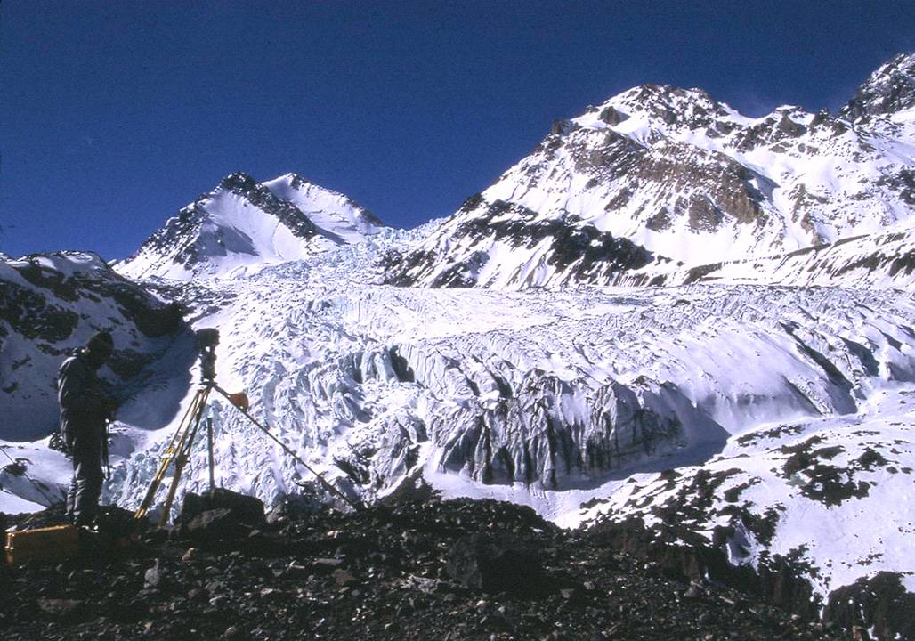


ARGENTINE ENVIRONMENT and CLIMATE CHANGE
JOSE BONINSEGNA Argentine NCP Environment and Climate Change

Slide 2
Argentine ecological regions
Argentina is extended from 22° L.S. to 55°L.S. with a wide diversity of climates and environments. However, five main ecological regions are easily recognized. Each one has particular environmental characteristics and problems.
The North-West portion of the country has mountains, deserts and a special subtropical forest, the “yunga” particularly reach in biodiversity. The eastern part of the region is dominated by the “Monte Chaqueño” a woody dry forest. Deforestation due to agriculture pressure, floods and droughts and social unrest for land competence are common threads.
The North Eastern part has abundance of water, a minimum rest of subtropical jungle (preserved in a National park), forest plantation (mainly Pines) and cattle ranches. Main problems are floods, droughts and land use changes.
The West Central part is dominated by desert environments, but trough irrigation an oasis economy is flourishing. Intensive agriculture, fruits and wine production are the drivers of the economic activity. The principal concern is the dependency on the snow accumulated in the high mountain for irrigation. Climate change models forecast future scenarios of water shortage.
The Central Pampas is a flat plain with the landscape dominated by extensive agriculture (corn, wheat, sunflower, and soybean) and cattle “estancias”. The main environmental problems are floods, drought, and water pollution. In this region, are also concentrated more that the 50 percent of the total population, mostly in big urban areas.
The Patagonia occupies the southern part of Argentina. It is a complex region mainly dominated by a windy steppe, with an extensive marine littoral, and in the west portion, a narrow frame of mixed southern beech forest (the Andino-Patagonica Forest). Patagonia is recognized as one of the most suitable areas of the world to produce wind electricity.

Slide 3
Climate Change Predictions
Time frame: 2090-2100
Scenario: A2
+wet
Warmer (+3.4°C)
Dryer in the mountains
Wetter in the foothills
Warmer (+4.0°C)
Dryer in the west
No change in the east
Warmer (+3.0°C)

Slide 4
Population: 3.500.000
PBG: 22.500.000.000 u$s
Exports: 2.400.000.000 u$d
Wine: 800.000.000 u$d
Fruits: 417.000.000 u$d
Garlic: 105.000.000 u$d
Olives: 90.000.000 u$d
Hydroelectricity: 12.400 Gw
Gas – Petroleum: 600.000.000u$d

Slide 5
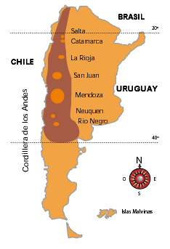
In Argentina, vineyards are growing at the Cordillera de los Andes foothills (Latitude 26°S to 40°S and Longitude 66°W to 69.50W).
The altitude of the valleys varied between 300m a.s.l. to 1659m a.s.l.
Despite the broad latitudinal extension landscape present several common characteristics

Slide 6
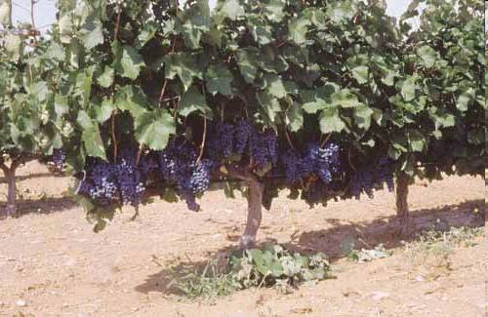
Social and Economics
Wine industry exports wine $ 700 million by year..
Near 80 percent of the wineries are Small and Medium Enterprises.
Grape growing and winemakers need high quantities of skilled labors, so they are considered important in the structuring of society.

Slide 7
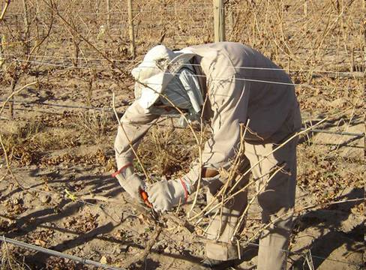
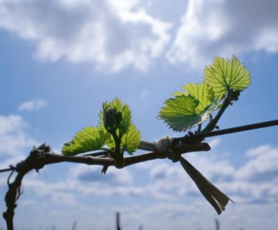
Labour-intensive agricultural practices are:
Harvest
Ties
Pruning,

Slide 9
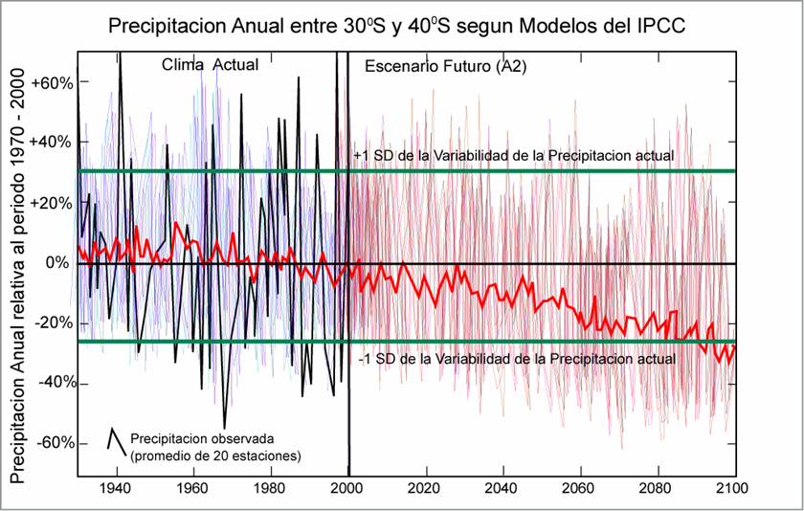

Slide 10
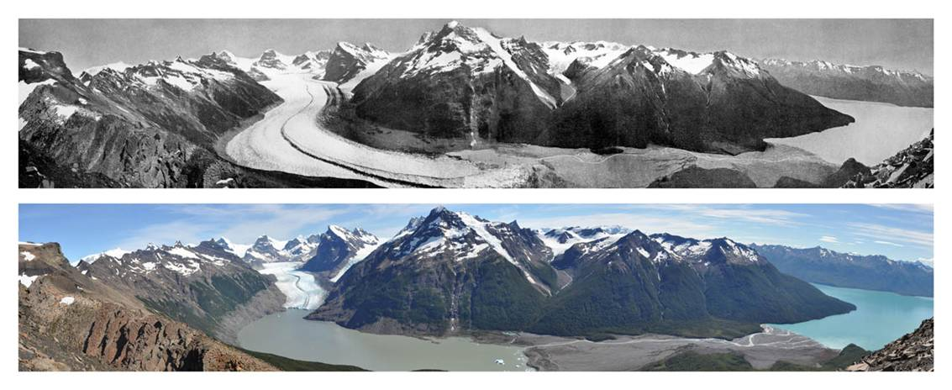
Glaciar Ameghino, Santa Cruz
1931-2010

Slide 11
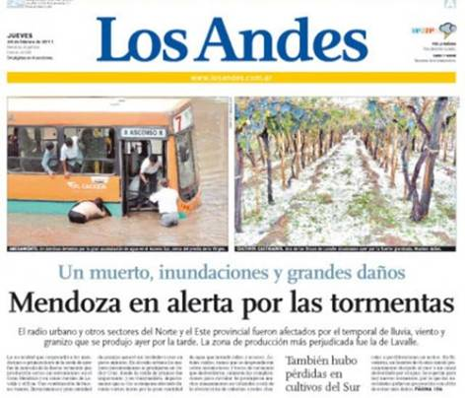
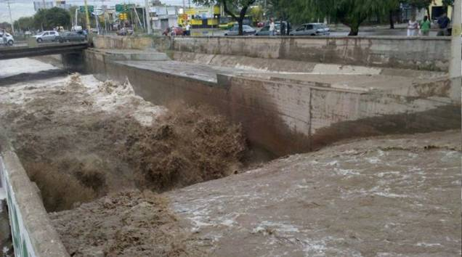
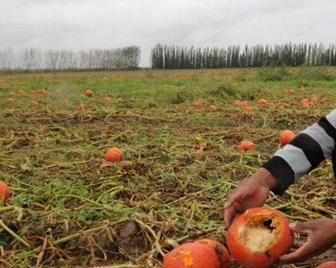
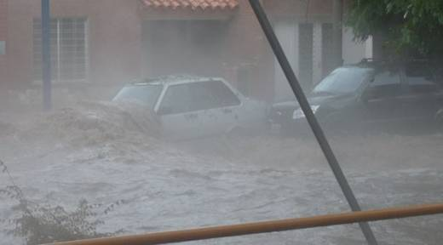
Risk and vulnerability

Slide 12
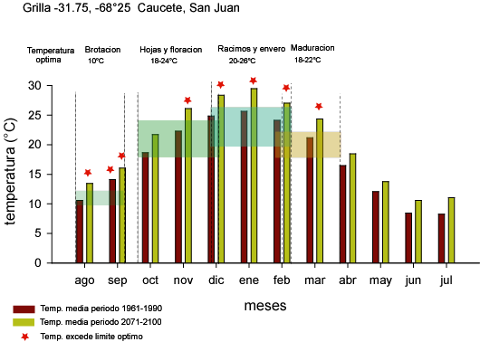
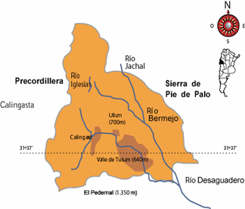
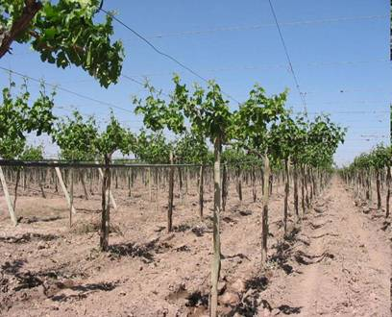
Altura: 566m. s.n.m.

Slide 13
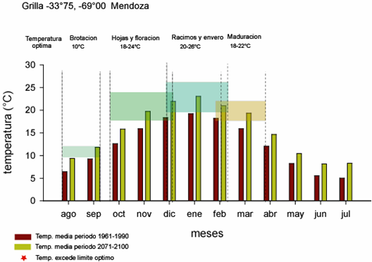
Valle de Uco
Altura 1150m s.n.m

Slide 14
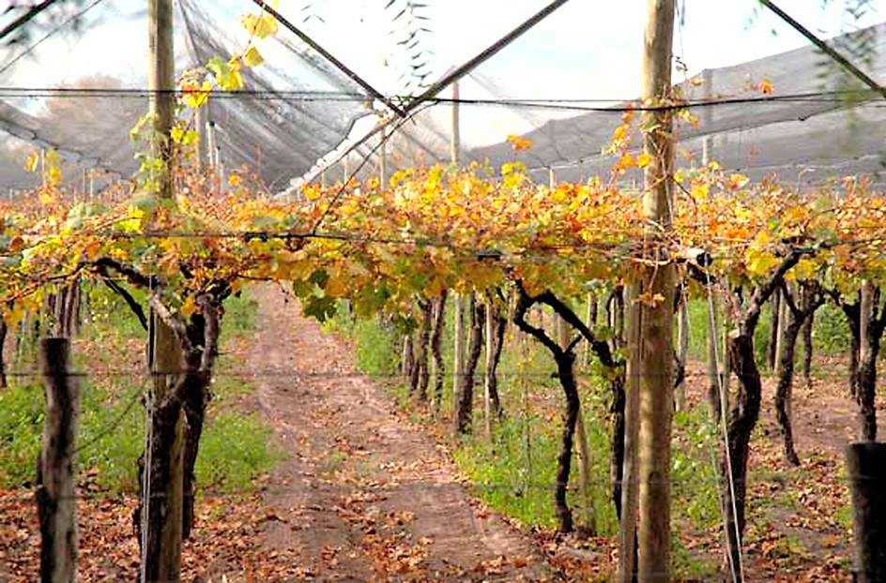
Vineyard with hail storm protection

Slide 15
Environmental Problems
Land Use: deforestation , lost of biodiversity, lost of soil
Urban Areas: Air pollution, waste management (including industrial effluents and garbage recycle) policies, environmental risks
Agriculture and livestock: Contamination of soils and water with agrochemicals and sub-products of farming. Arsenic in water table

Slide 16
Key competencies in Environment research fields
Ecotoxicology
Environmental chemistry an applied physics
Agriculture and Farm technology.
Meteorology and Climatology
Social sciences applied to environmental problems
Health sciences applied to environmental problems

Slide 17
SWOT analysis of the Environment research capacity in Argentina
Strengths: Appropriate human resources and research infrastructures, with high level of education and training in R&D,
Weaknesses Lack of articulation between different areas/institutions, lack of multidisciplinary conjunction of efforts. Lack of integration with policy makers and stakeholders
Opportunities Integration within groups in Argentina and Latin America to solve commons problems.
Threats: Short term vision of Policy makers, and lack of continuity of environmental policies.

Slide 18
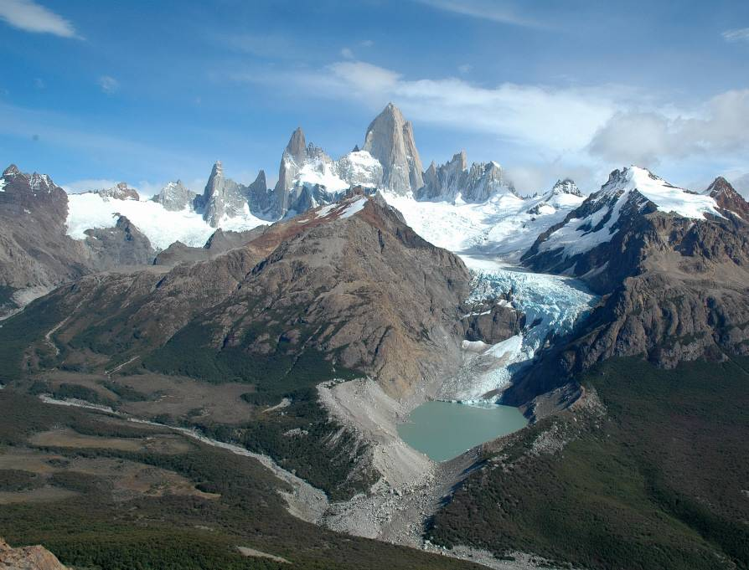
Thanks!

